Slide 1
MileMate
Notes:
Title Page

Slide 2
Team
Name | Title
John Kilmister | Project Sponsor
Martin Reid | Support Tutor
Tyler Short | Team Lead, Scrum Master, Documentation
Owen Bradstreet | Development, Database Expert
Steve Dawe | Server Ops, Presentation
Gaetano Archer | Development, Presentation
Jacob Shattock | Documentation, Design Prototyping
Potentially separate into divisions
Notes:
Team – Tyler

Slide 3
Problem Statement
The client company has a pool of cars and vans that are shared by employees as they are needed. These are used both for site visits and to transport equipment. The issue is that staff often find booking these an issue.
Staff currently use a set of shared outlook calendars for each vehicle however it can be hard to find one that is free and book it.
Notes:
Problem Statement - Tyler

Slide 4
Solution Proposal
The client company’s employees struggle to book company vehicles, currently using outlook calendars to book each vehicle. We aim to develop a user-friendly web application to improve this experience and save time for the employees.
Notes:
Solution Proposal - Tyler

Slide 5
Requirements
Requirements
Authentication
Vehicle Management
Booking System
User Interface
Nice to have features
Data Security
API
Problem statement (Link to)
Solution (Link to)
Requirements
Table of requirements(Image)
+ Nice to have features(Image)
Notes:
Requirements - Jacob
Problem statement (Link to)
Solution (Link to)
Requirements
Table of requirements(Image)
+ Nice to have features(Image)

Slide 6


Team collaboration
Notes:
Teams Collaboration - Owen
Sharing documentation – Teams files
Communication – Teams and Discord
Weekly updates

Slide 7
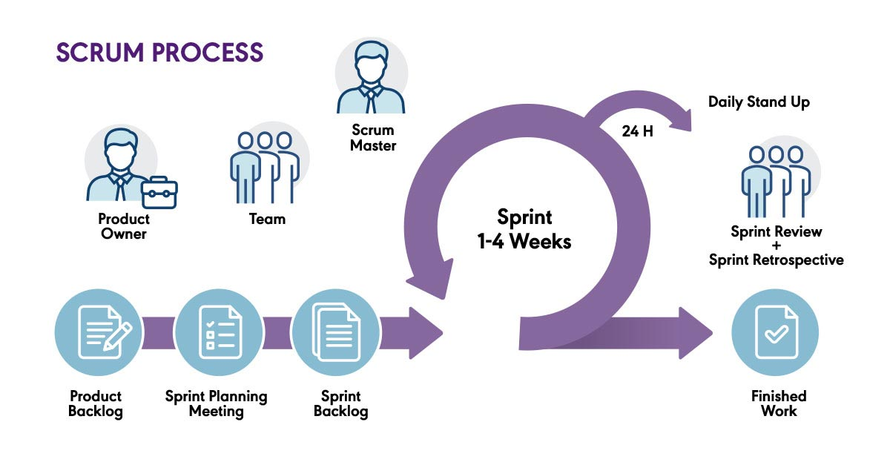
Sprint Routine
Notes:
Sprint Routine - Tyler
Weekly updates
Monday and Thursday

Slide 8
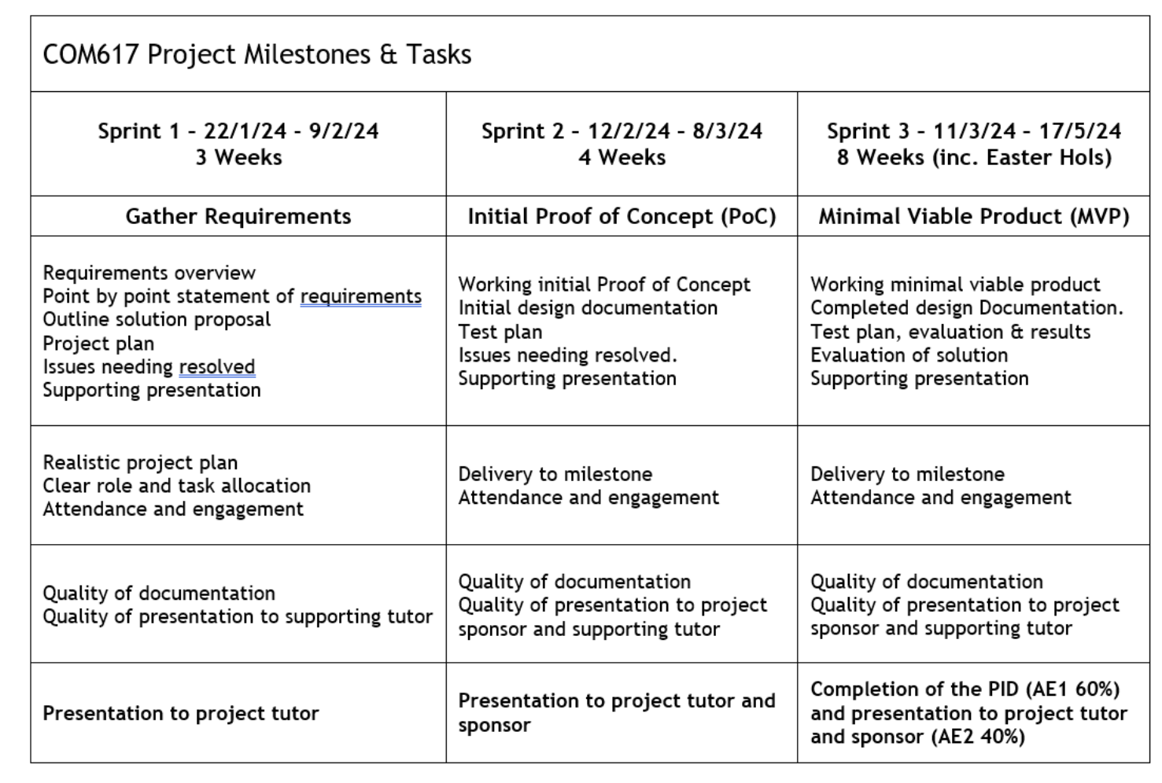
Sprints(1, 2, 3)
Notes:
Sprints(1, 2, 3) - Gaetano
Link back to requirements and solution, talk about what we need in each sprint

Slide 9
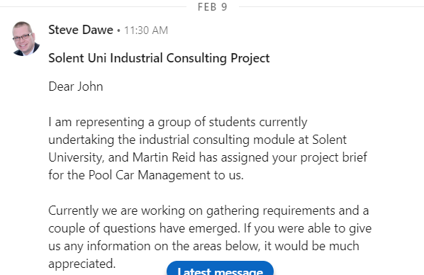
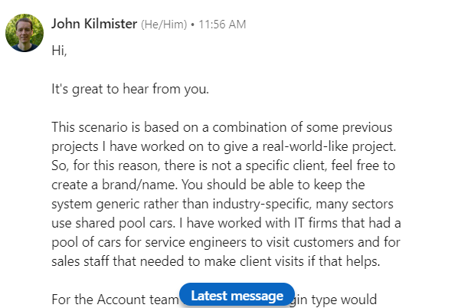
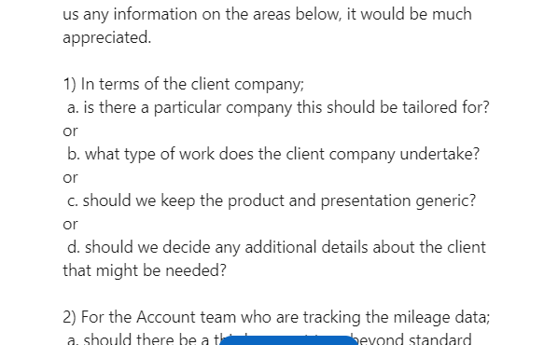
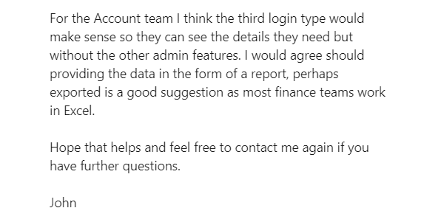
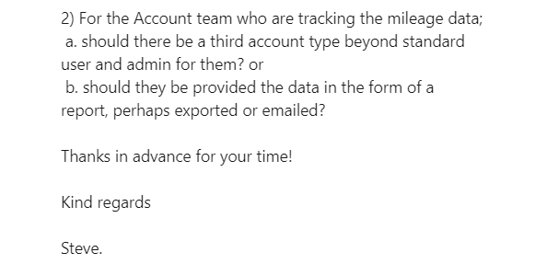
Feedback
Notes:
Steve
Having reviewed the project brief, we worked through the details and established the requirements. Following our group discussions, there were a couple of areas we were keen to get some clarification on. We made contact with the project sponsor, John Kilminster through linkedin, outlining out questions. John provided additional information back to us and were used this feedback to inform our project specifications. At the end of Sprint 1, the group were able to present our initial concept for a solution to the project brief. During this meeting, John provided feedback and additional information, particularly around the use of Github actions for the automation of project deployment. This feedback was worked into our project plan,

Slide 10
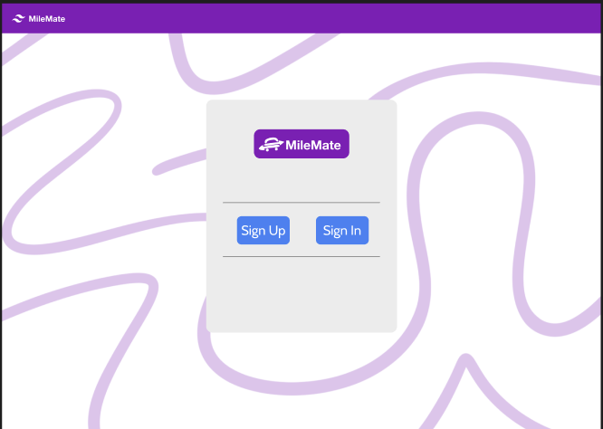
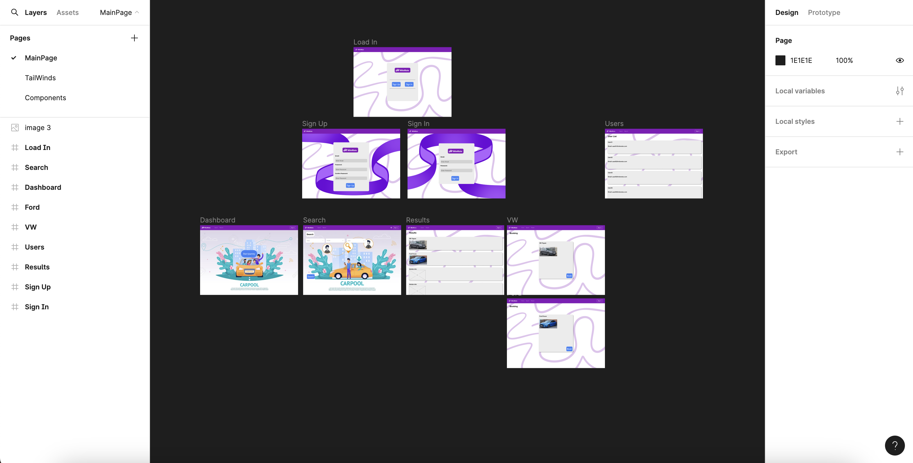
Figma
Notes:
Figma - Jacob

Slide 11
Frontend
Tailwinds
Blazor
(Figma)
Notes:
Frontend Owen
Tailwinds
Blazor
(Figma)

Slide 12
Tailwinds
Notes:
Tailwinds

Slide 13
Backend
Blazor
C#
Notes:
Owen

Slide 14
Database
MongoDB (Image of database)
Why we used mongoDB
Link to why (Appendices)
Reasons as to why: Unstructured,
Link back to requirements
Notes:
Owen

Slide 15

Hosting/Server
Notes:
Hosting/Server - Steve
Azure
Deployment?
(Link to Github Actions)
(Link to PID)

Slide 16
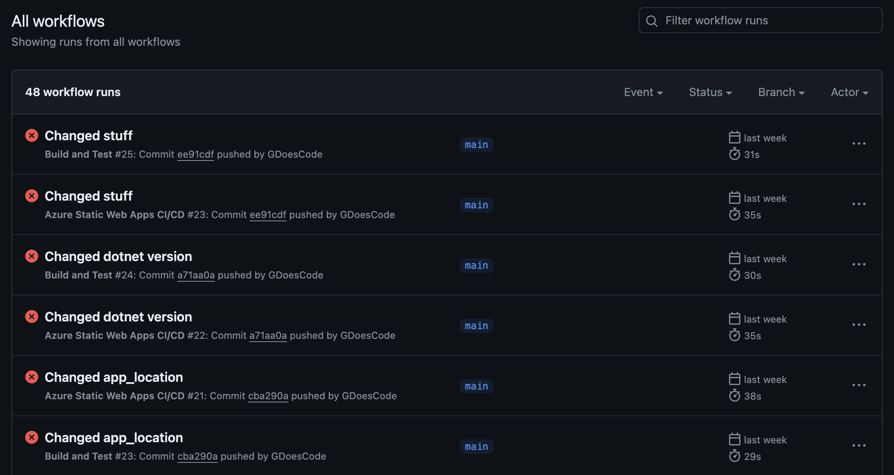
Github Actions
Notes:
Github Actions - Gaetano
How it builds the application
How it Tests the application
How it deploys the application

Slide 17
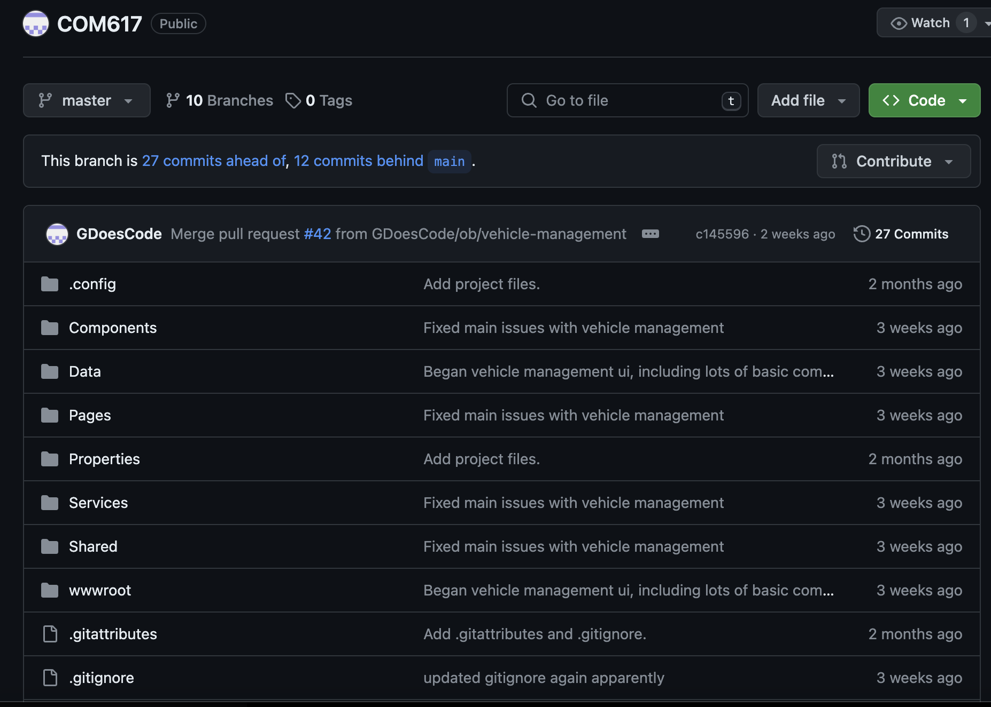
Github Version Control
Notes:
Github Version Control - Gaetano
Main branch – Final deployed product
Master branch – Final undeployed product
Dev branches – Individual tasks
(Animate between, images of branches)

Slide 18
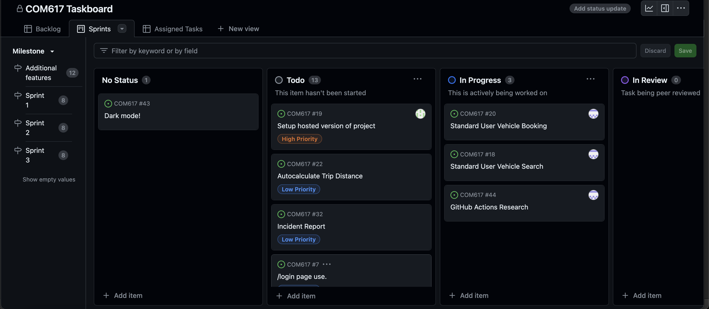
Github Project
Notes:
Github Project - Gaetano
Kanban board (Sprint 1 -3 and additional features)
Backlog
Priority

Slide 19
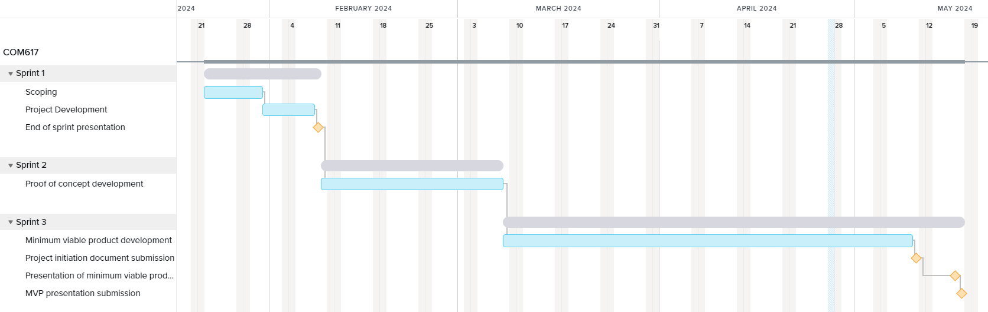
Project Milestones
Milestones for each sprint
(Link to proposed solution)
Notes:
Project Milestones - Steve
Milestones for each sprint
(Link to proposed solution)

Slide 20
Creation of the company

Slide 21
Discussion on extra components
Incident reports
Notes:
Owen

Slide 22
Exclusions
Advanced Testing
Edge cases
Dark Mode?
Notes:
Steve

Slide 23
Future development
Future problem
Notes:
Steve

Slide 24
Summary

Slide 25
Thank You Any Questions?

